Slide 1
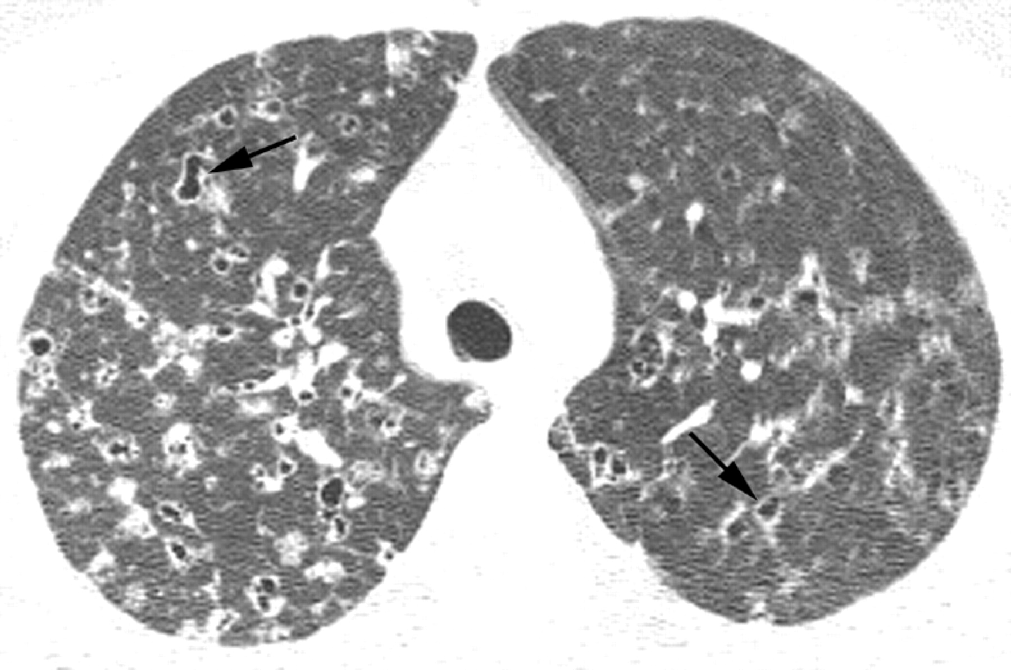

Patient with suspected idiopathic interstitial pneumonia: alternative diagnosis established with high resolution (HR) CT imaging.
Michael B Gotway et al. Thorax 2007;62:546-553
Copyright © BMJ Publishing Group Ltd & British Thoracic Society. All rights reserved.
Notes:
Patient with suspected idiopathic interstitial pneumonia: alternative diagnosis established with high resolution (HR) CT imaging. Axial HRCT image through the pulmonary apices shows bilateral bizarre-shaped cysts (arrows) and nodules characteristic of Langerhans’ cell histiocytosis.

